Slide 1


SMART
BAR
TECHNOLOGY
Revolutionizing the at Home Bar Experience
By Rudy Parra

Slide 2

Student Biography
Rodolfo Gonzalez Parra Jr. (Rudy)
25yrs old, First Gen Mexican American
StemCore & ALRISE Member
School: Central New Mexico Community College
Major: Computer Information Systems
Concentration: Network and System Administration
Related Experiences In STEM Fields:
Computer Science
Networking & System Automations
OS Imaging & Deployment
Engineering
Data Analysis
Solar and Space Physics
Glass Physics
Chemistry
Labratory Experience:
National Solar Observatory (NSO) - Boulder, Colorado
Lockheed Martin - Baltimore, Maryland
Coe University Physics Department - Cedar Rapids, Iowa

Slide 3

THE JOURNEY TO MAKING
A
SMART BAR

Slide 4
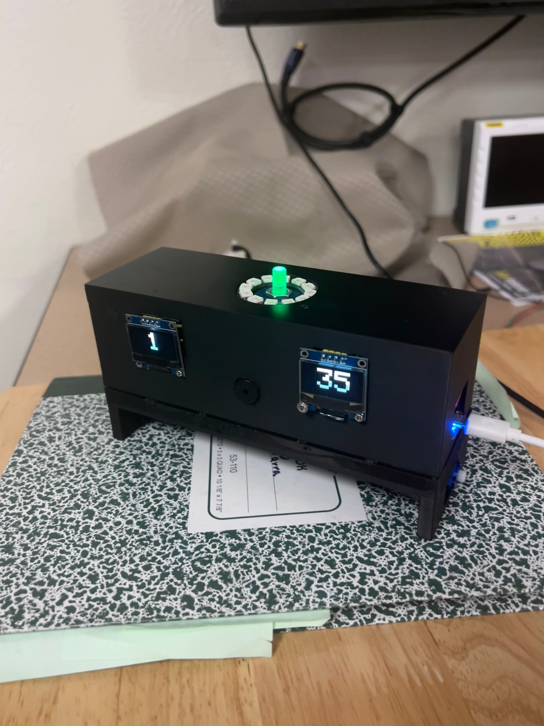
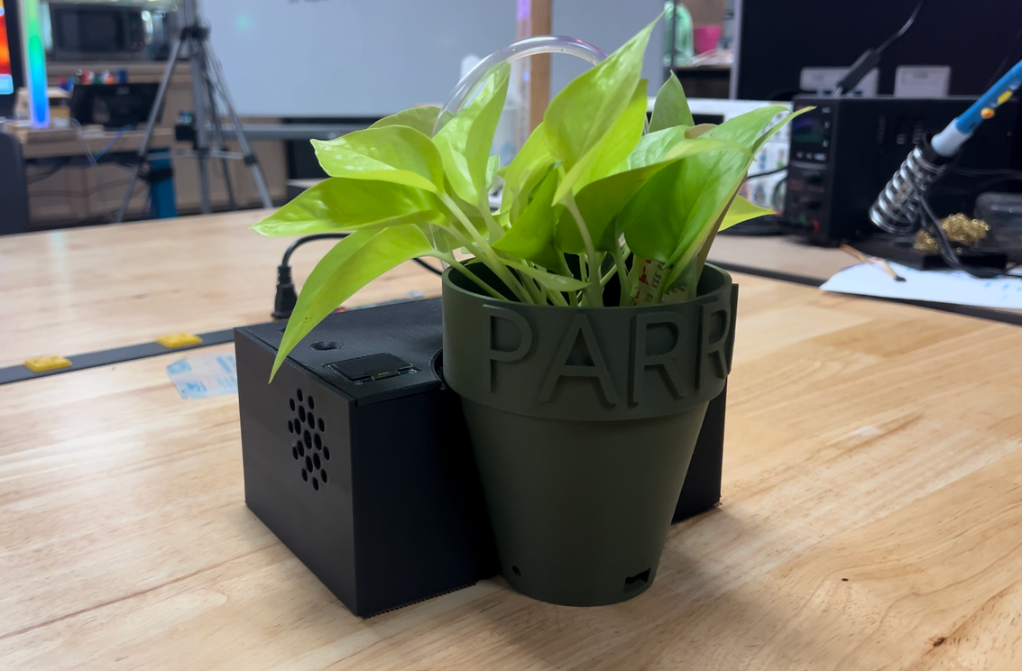
PAST I.O.T PROJECTS
Smart Alarm Clock Room Controller
Self Watering Plant

Slide 5
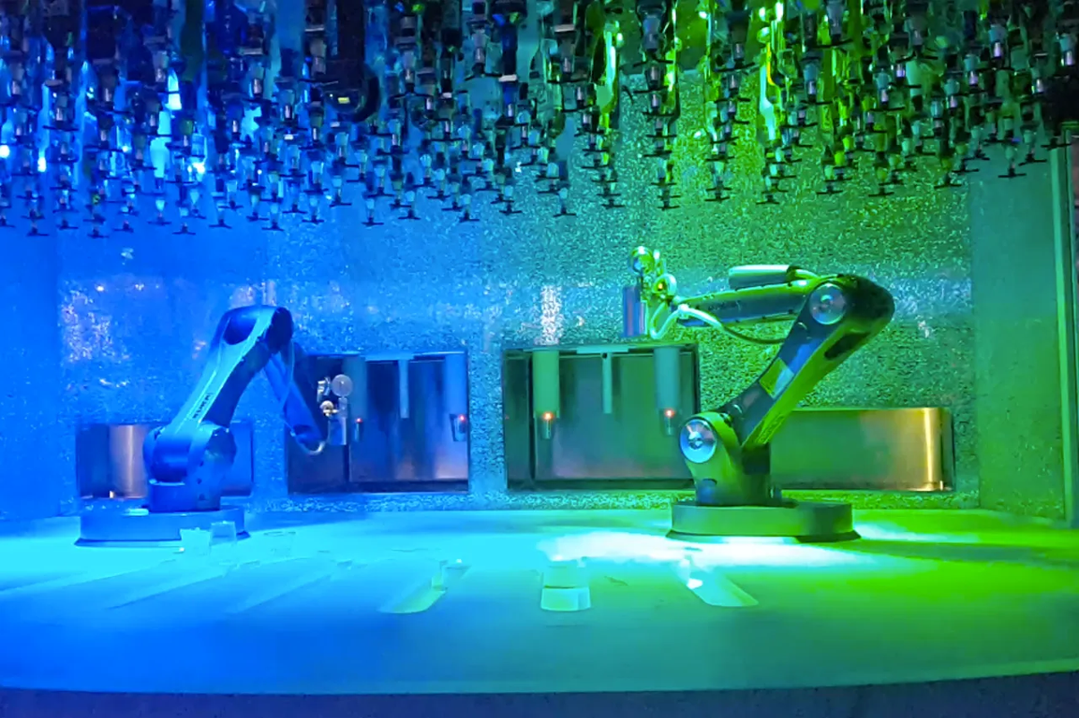
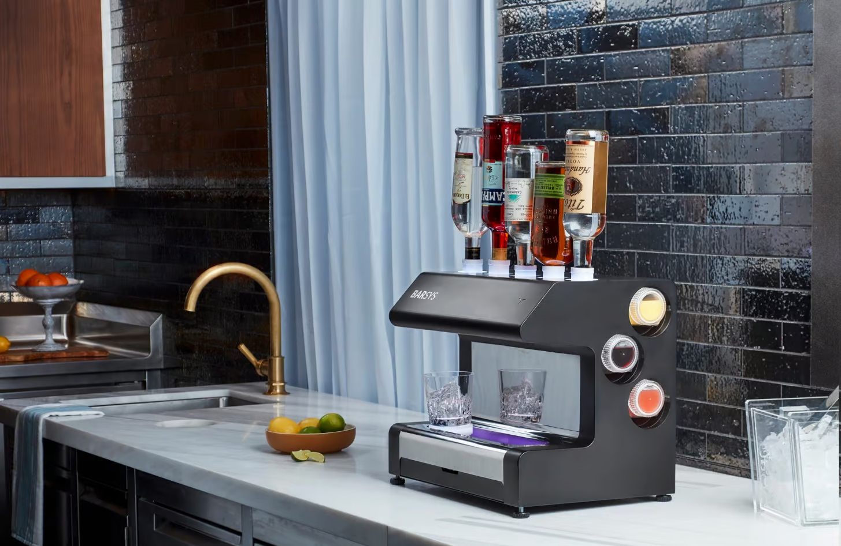
INSPIRATIONS
Smart Bar
with
Robotic Arm
Smart
at Home Bar

Slide 6

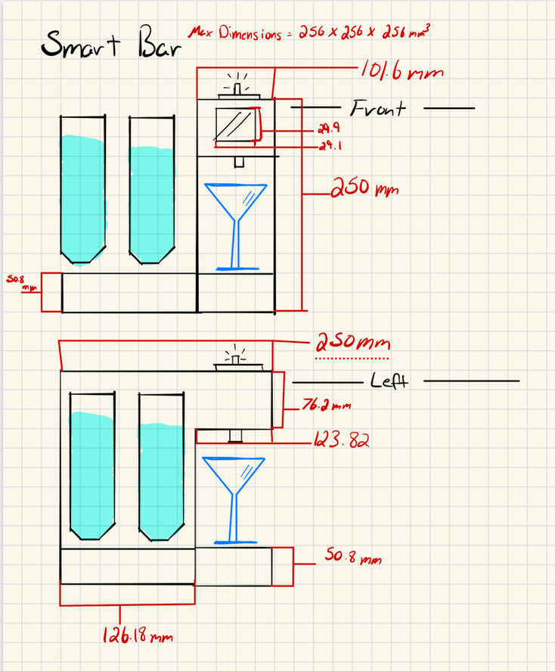
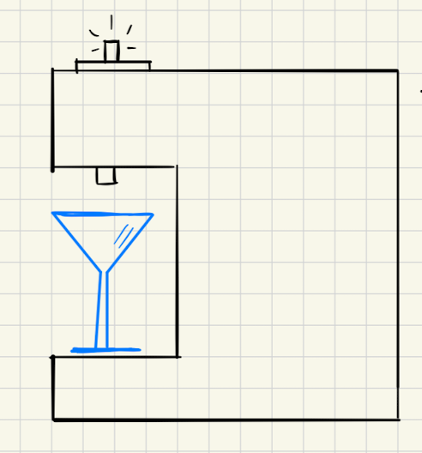
THE DRAWING BOARD

Slide 7
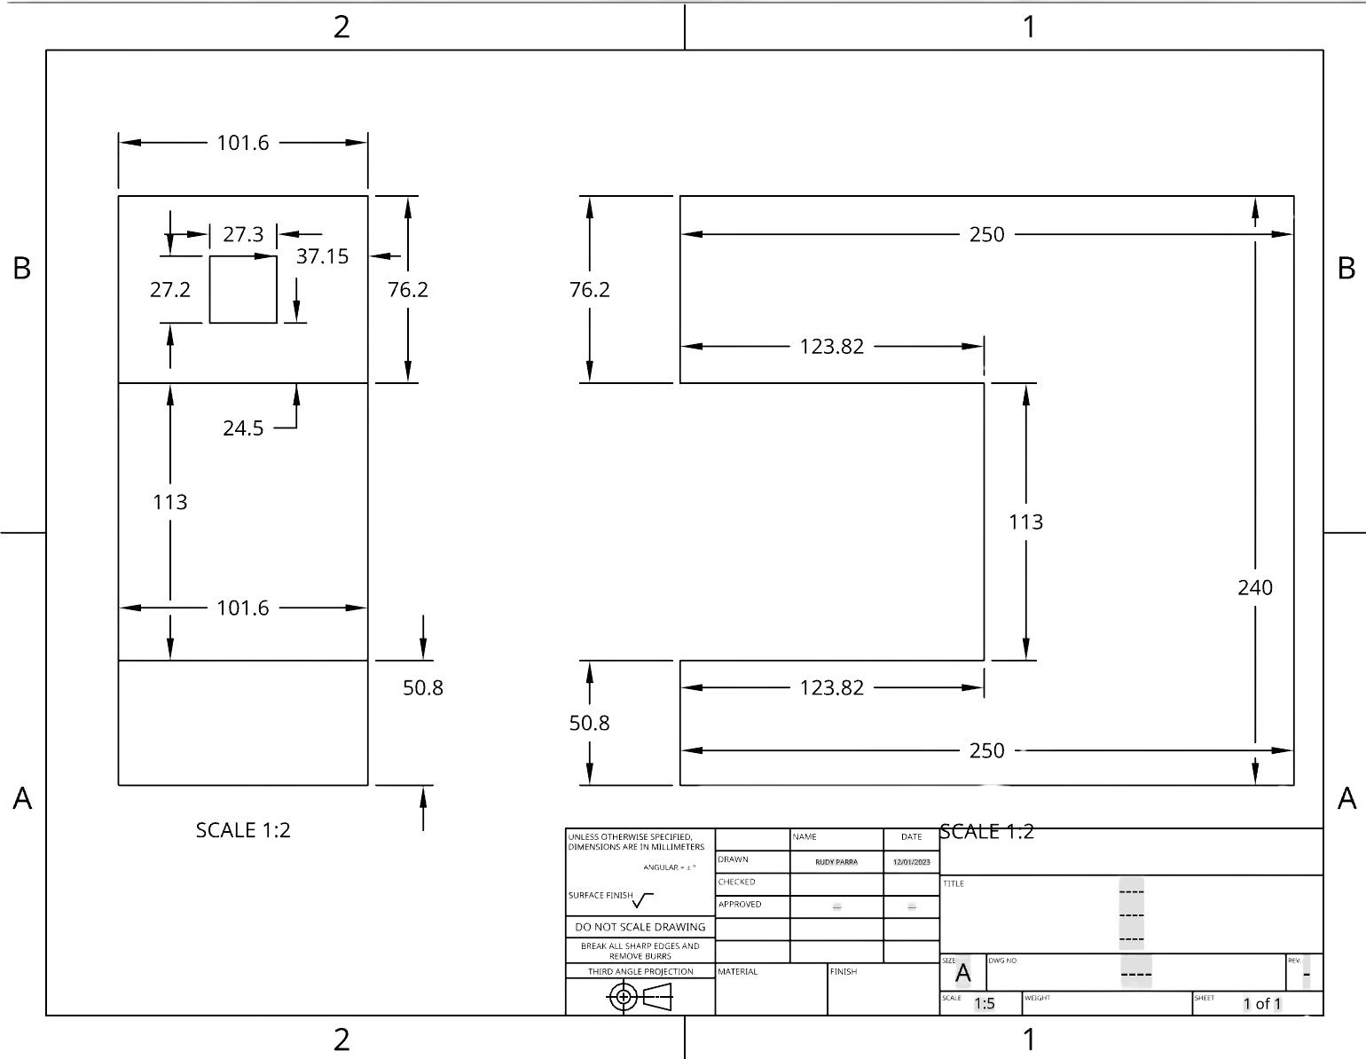
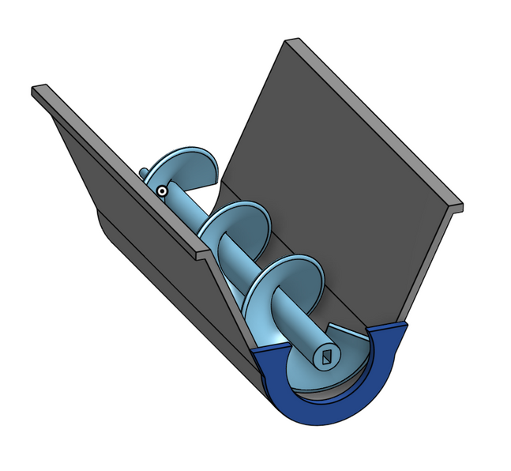
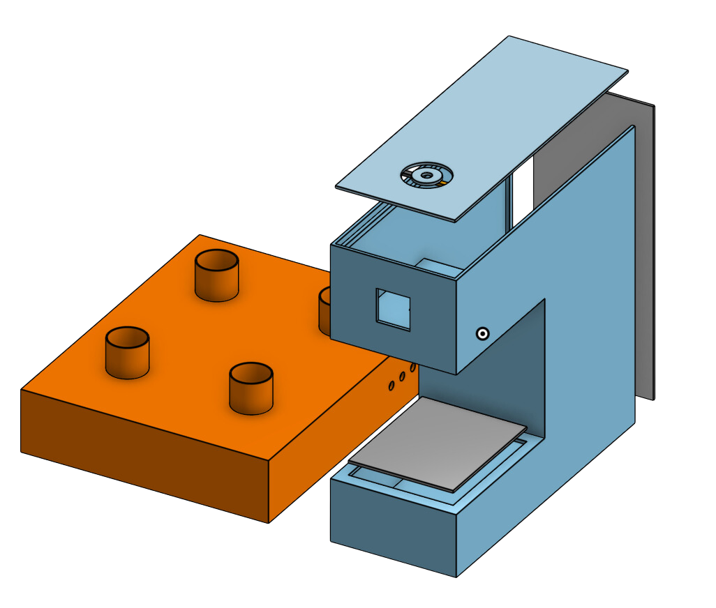
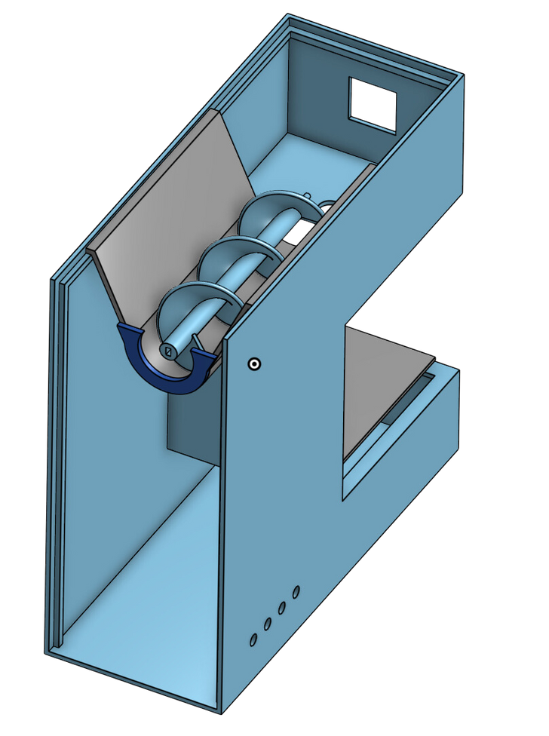
CAD DESIGN

Slide 8
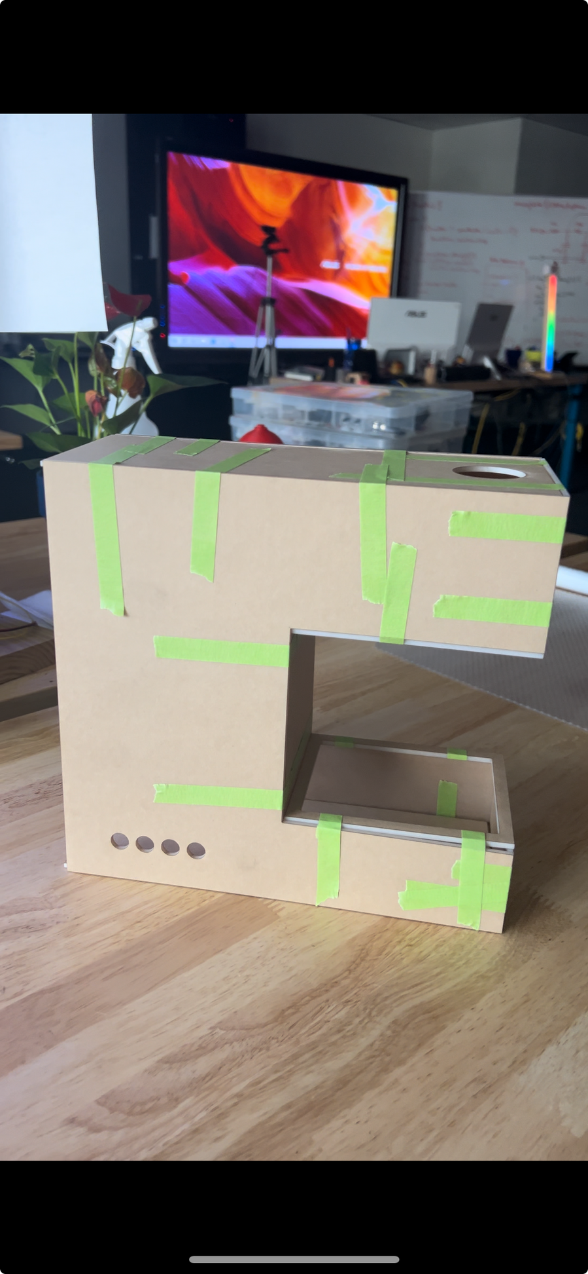
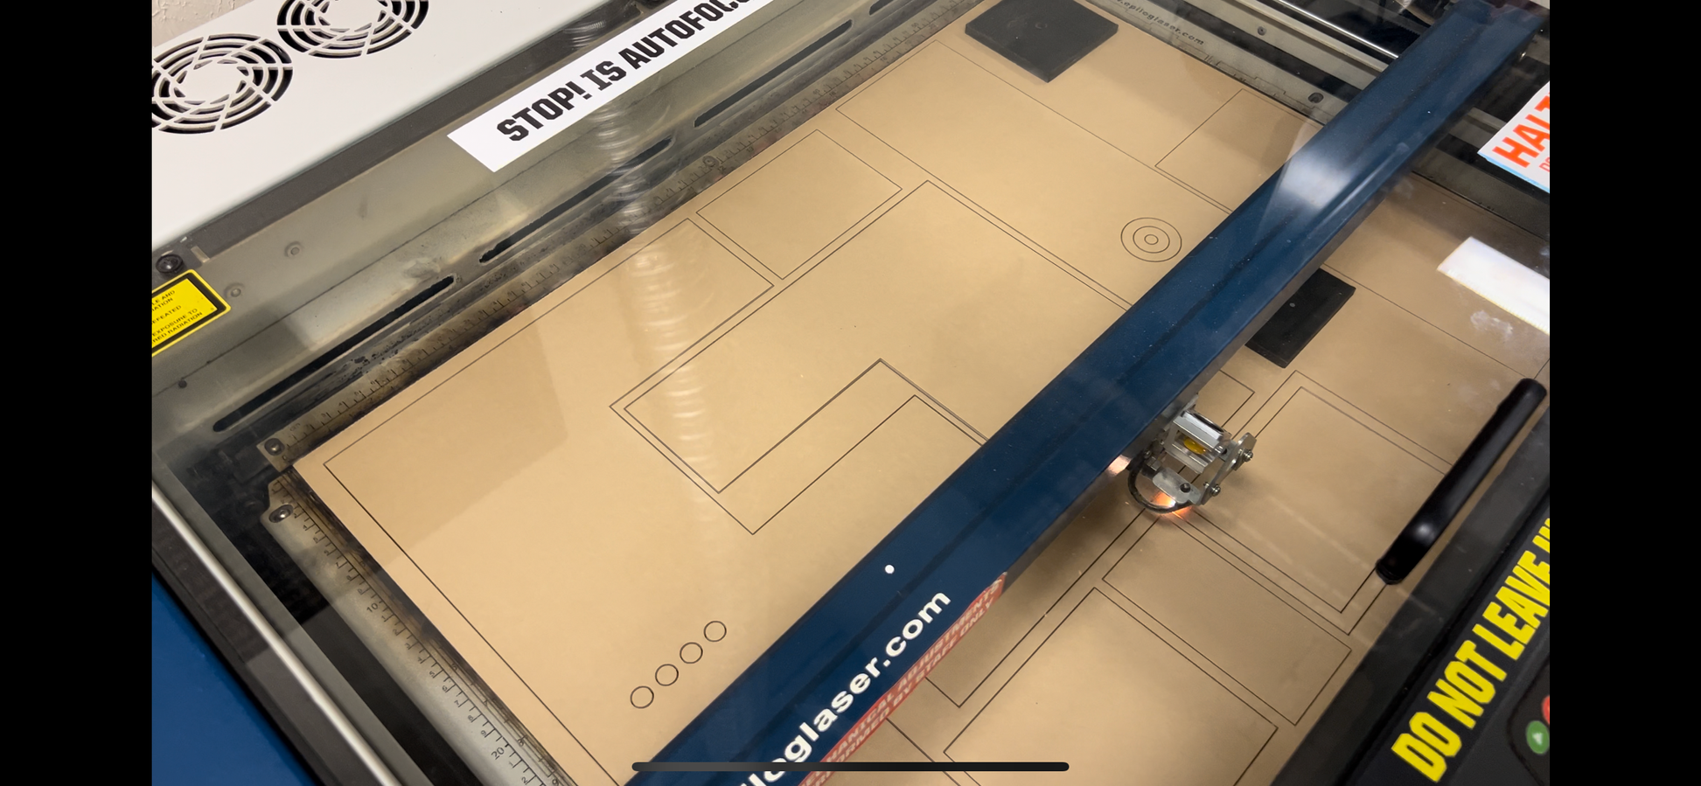
Laser Cutting & Constructing

Slide 9
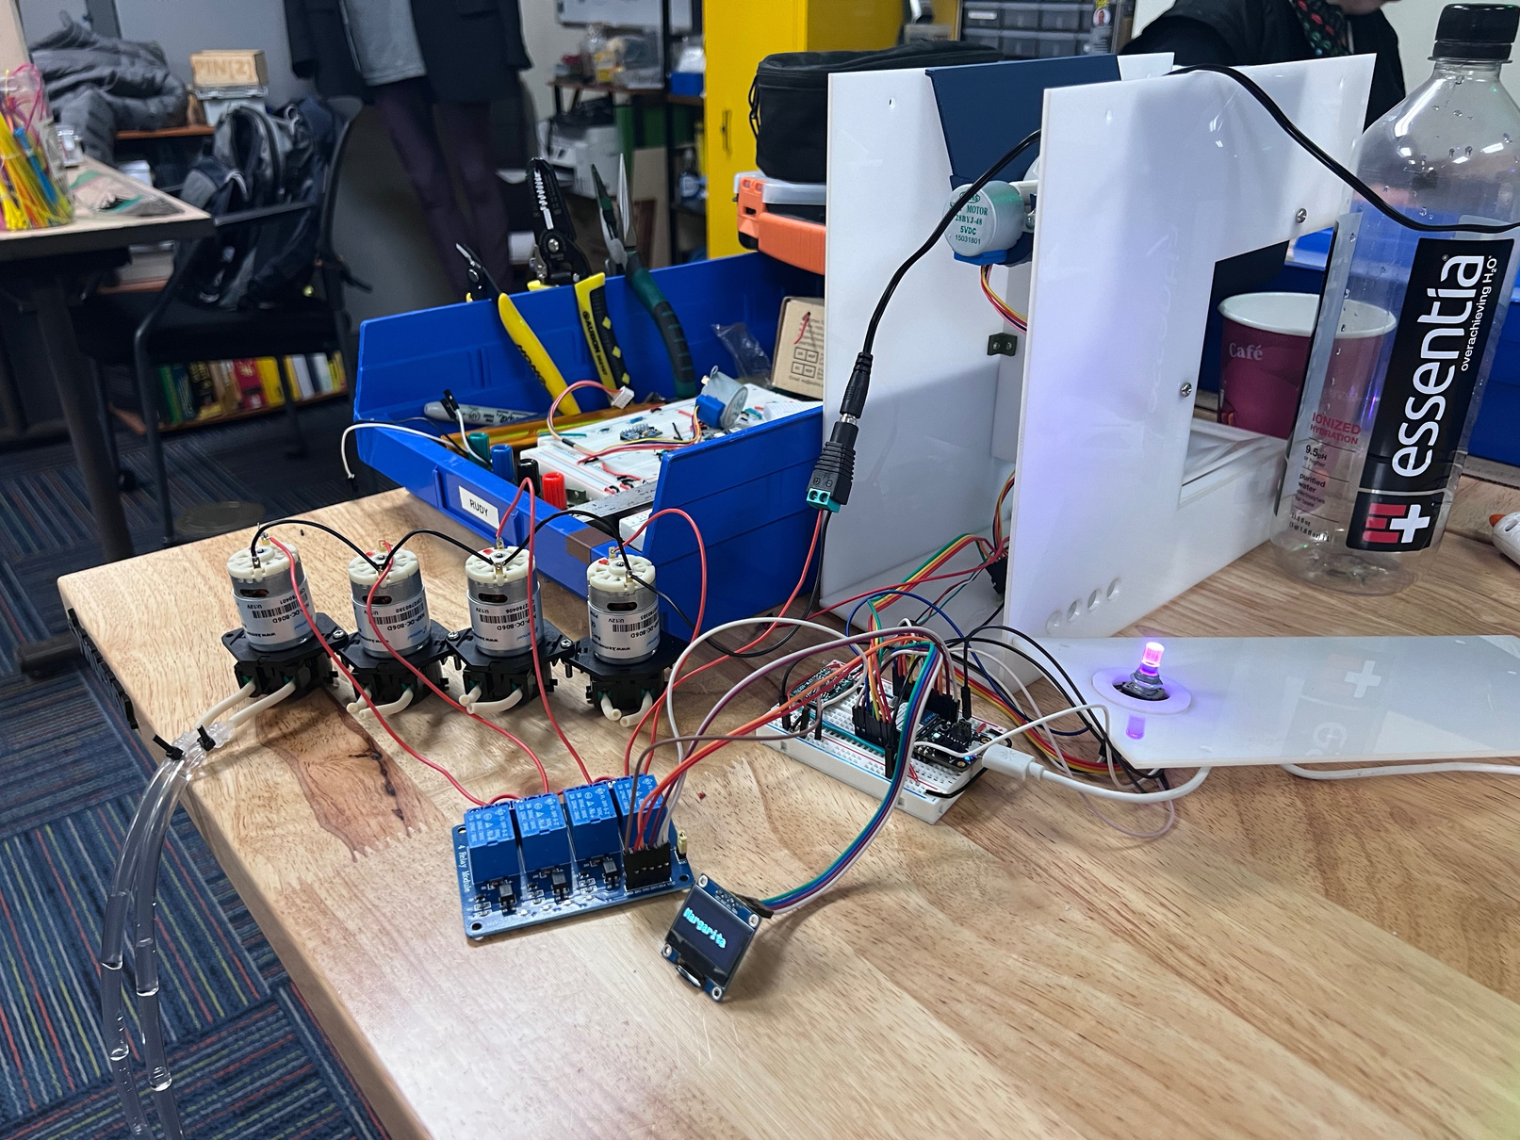
HARDWARE
1x Particle Photon 2
1x OLED Screen
1x Stepper Motor
1x Encoder
1x Load Cell
4x 12v Pumps
1x 4way Relay
1x 12v Power Supply

Slide 10
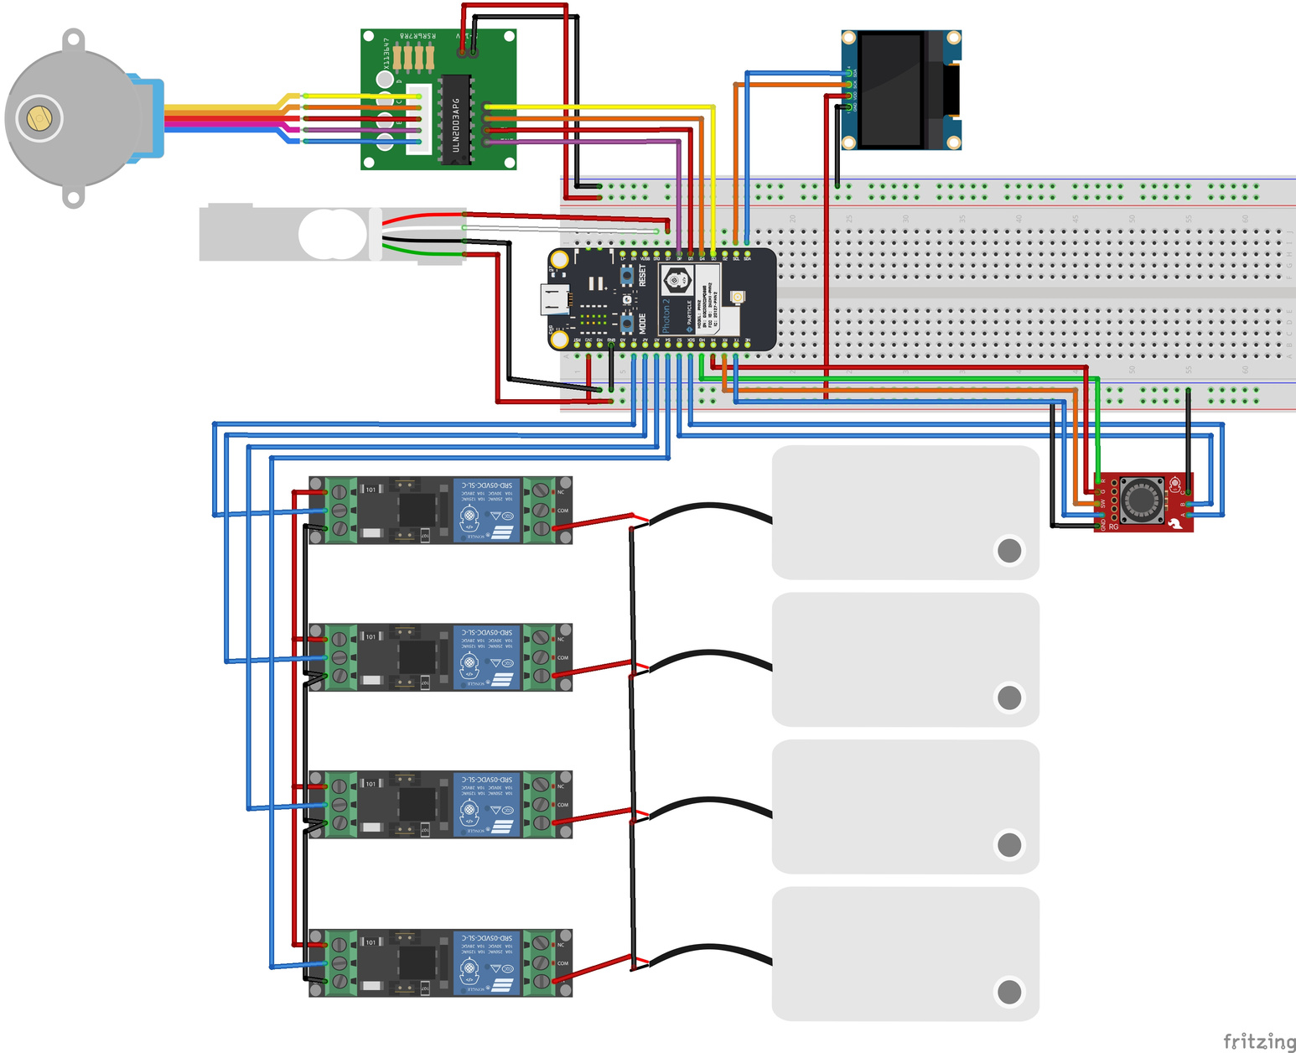
Fritzing Diagram

Slide 11
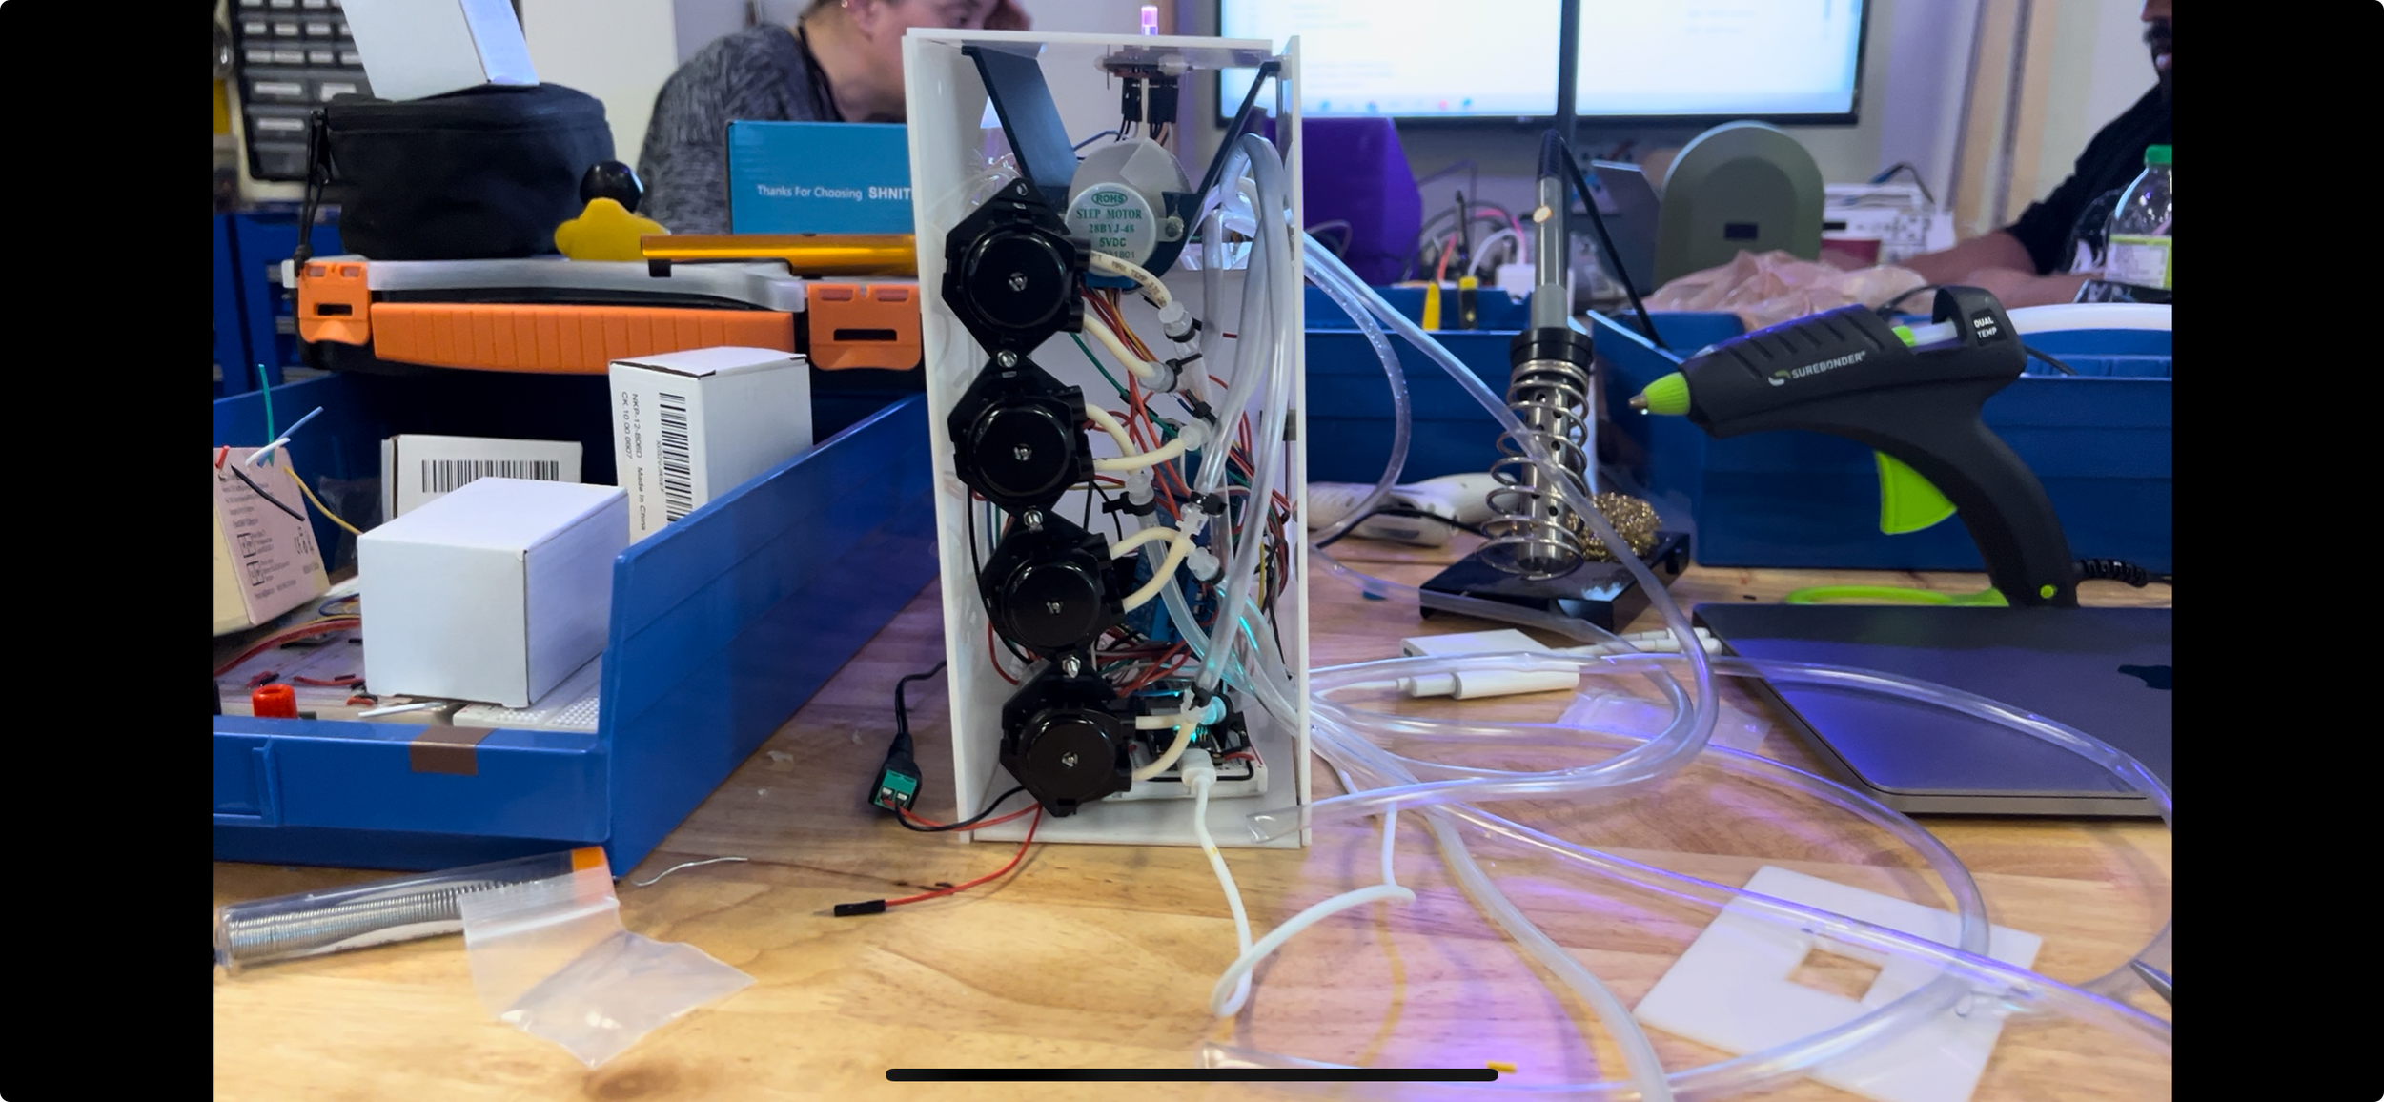
ASSEMBLING

Slide 12
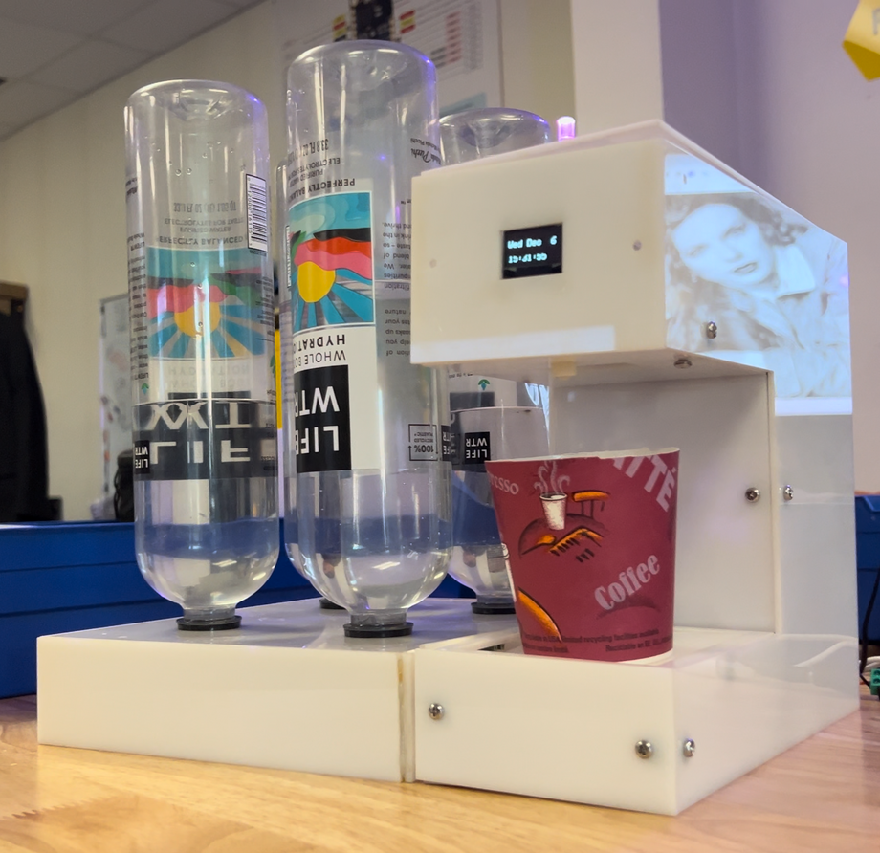
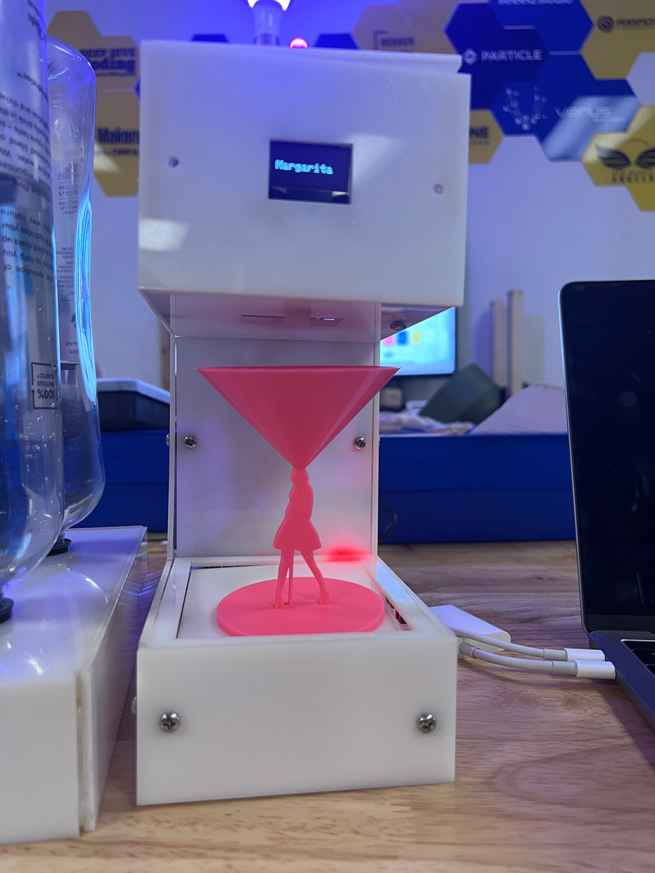
The Proof of Concept

Slide 13
DEMO

Slide 14

"TECHNOLOGY IS JUST A TOOL. IN TERMS OF GETTING THE KIDS WORKING TOGETHER AND MOTIVATING THEM, THE TEACHER IS THE MOST IMPORTANT."
-Bill Gates

Slide 15
Q&A

